Slide 1
Evolution of Airports in United States of America
Team Members:
Anusha Ramamurthy
Santhosh Soundararajan

Slide 2
Concept
A Time Series Visualization of the Airline Industry, animating the onset of different airports at various locations across the United States.
Research Questions
We wanted to visualize the air travel industry in USA. Which were the first airports to be established?
how did certain airports go from being scarcely used to one of the busiest airports in the world?

Slide 3
Motivation
There is a plethora of Flight visualizations on the flight routes, flight delays and airport to airport maps of routes.
But there is no real chronicle on how this huge air transportation network evolved from its onset.
This was compelling reason for us to venture into this wide corpus of data spanning over 21 years! (over 10gb of data)

Slide 4
Data Wrangling
Source: http://stat-computing.org/dataexpo/2009/the-data.html
Initial Data
From 1987 to 2009
Details
each file had around 1,041,827 rows,29 columns
Cannot be processed in Excel
Hence we found the best way to take the columns we were interested in was by using Python

Slide 5
Data Wrangling
We wanted the number of times the location acted as a Source and acted as a Destination
We realized a simple value_counts with slicing of 20 would not work because a certain airport may be the Origin more frequently than a Destination, or vice versa

Slide 6
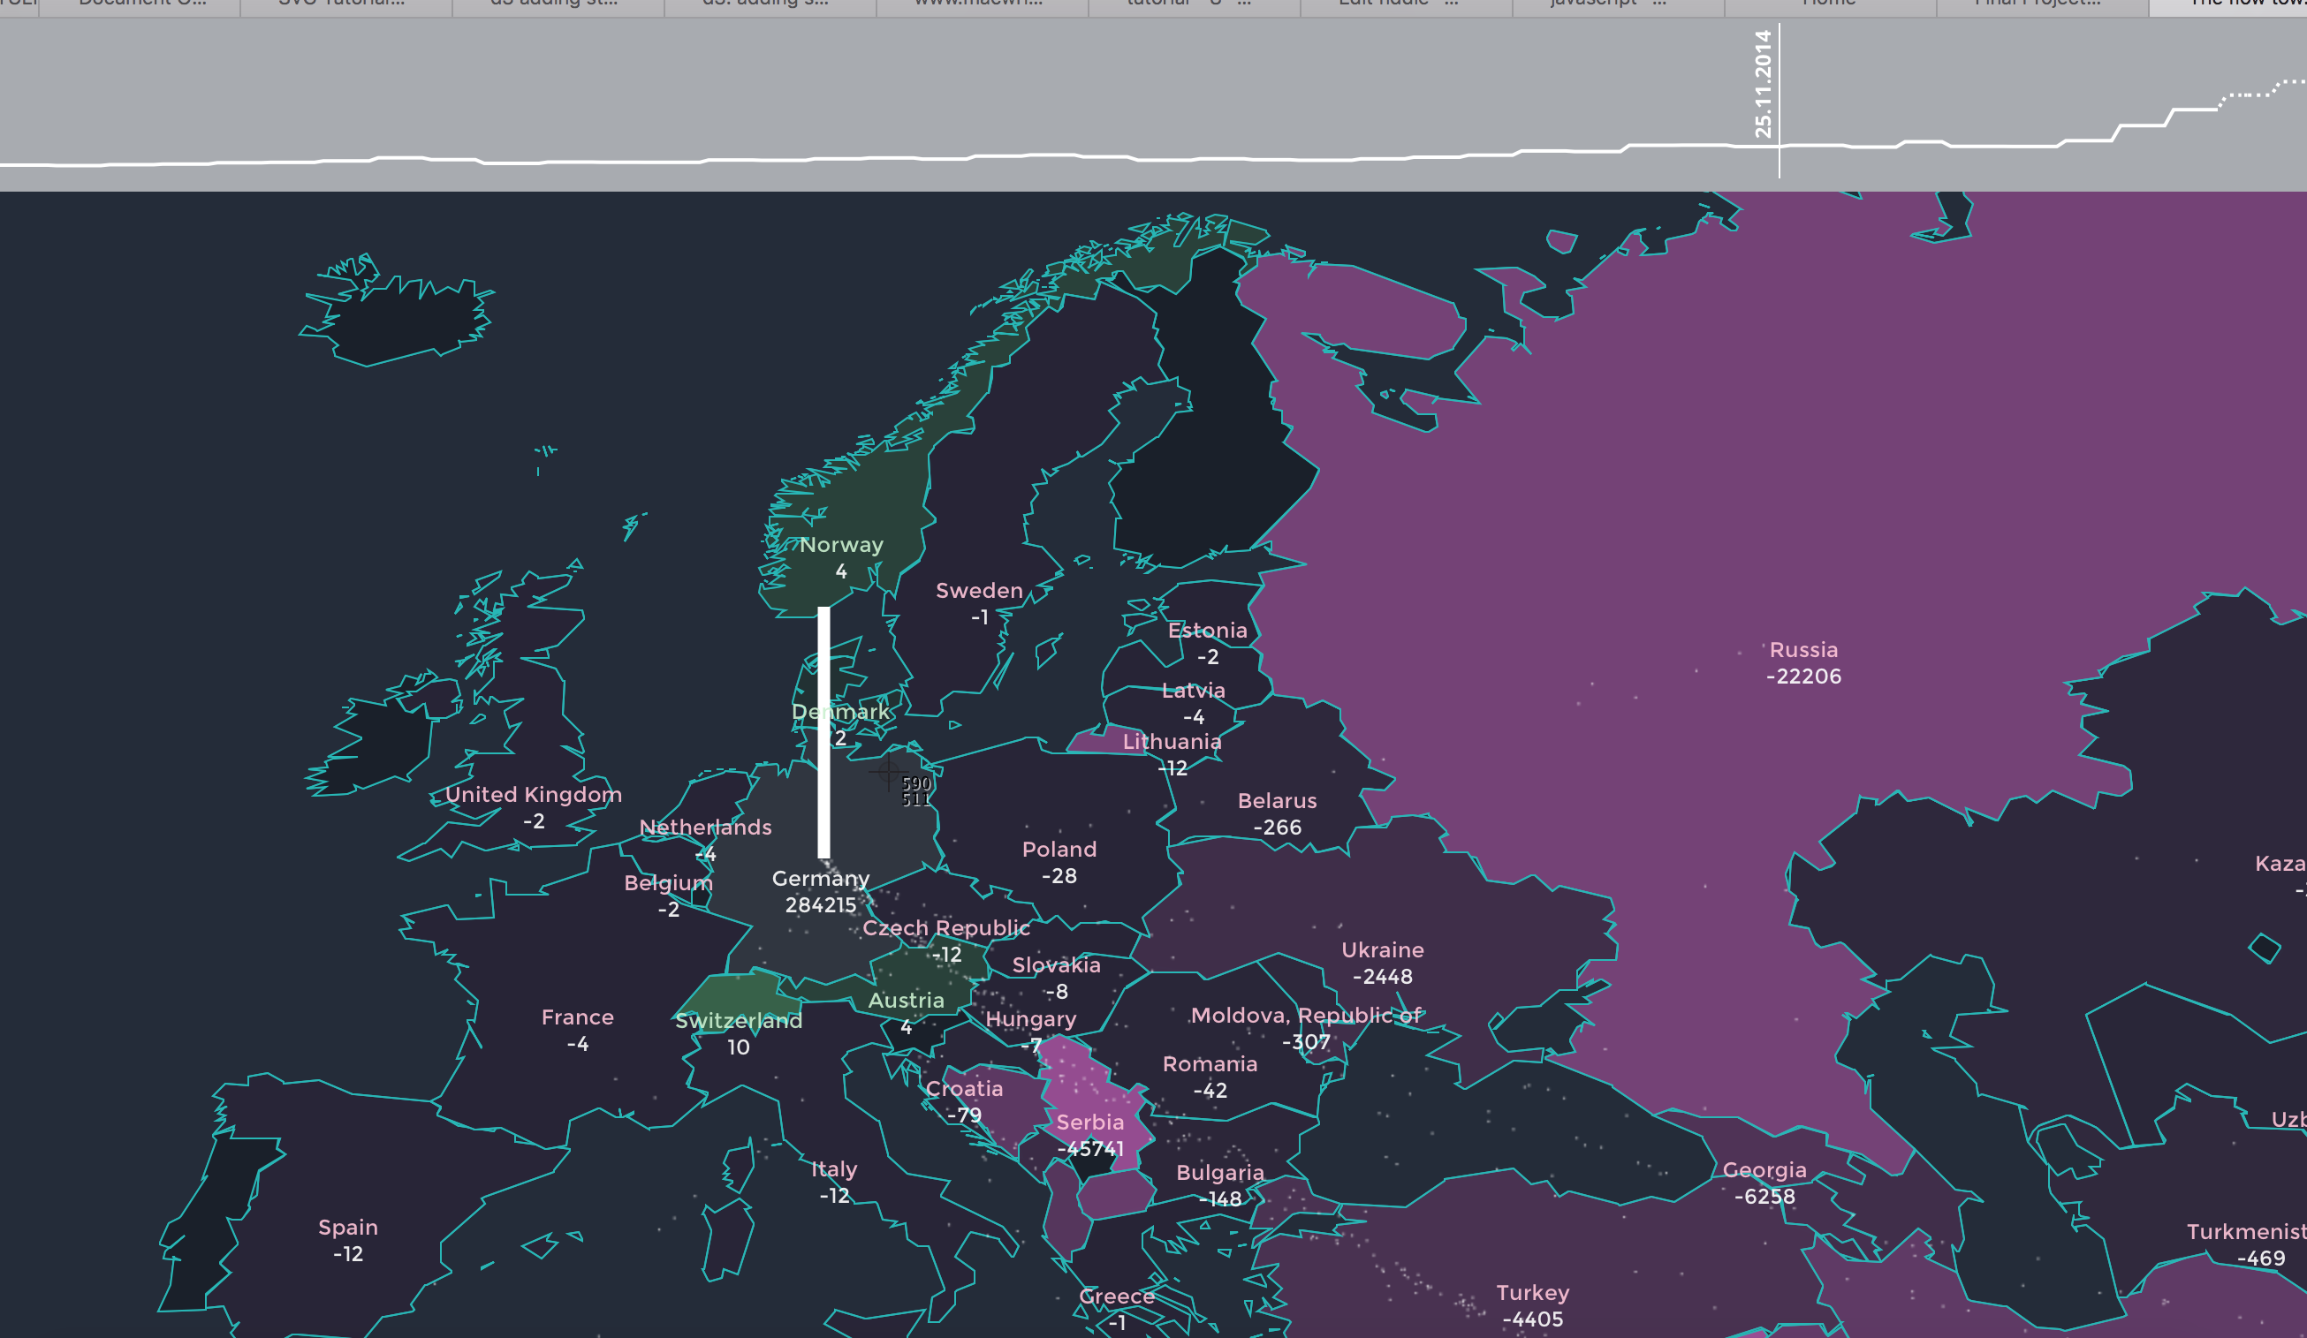
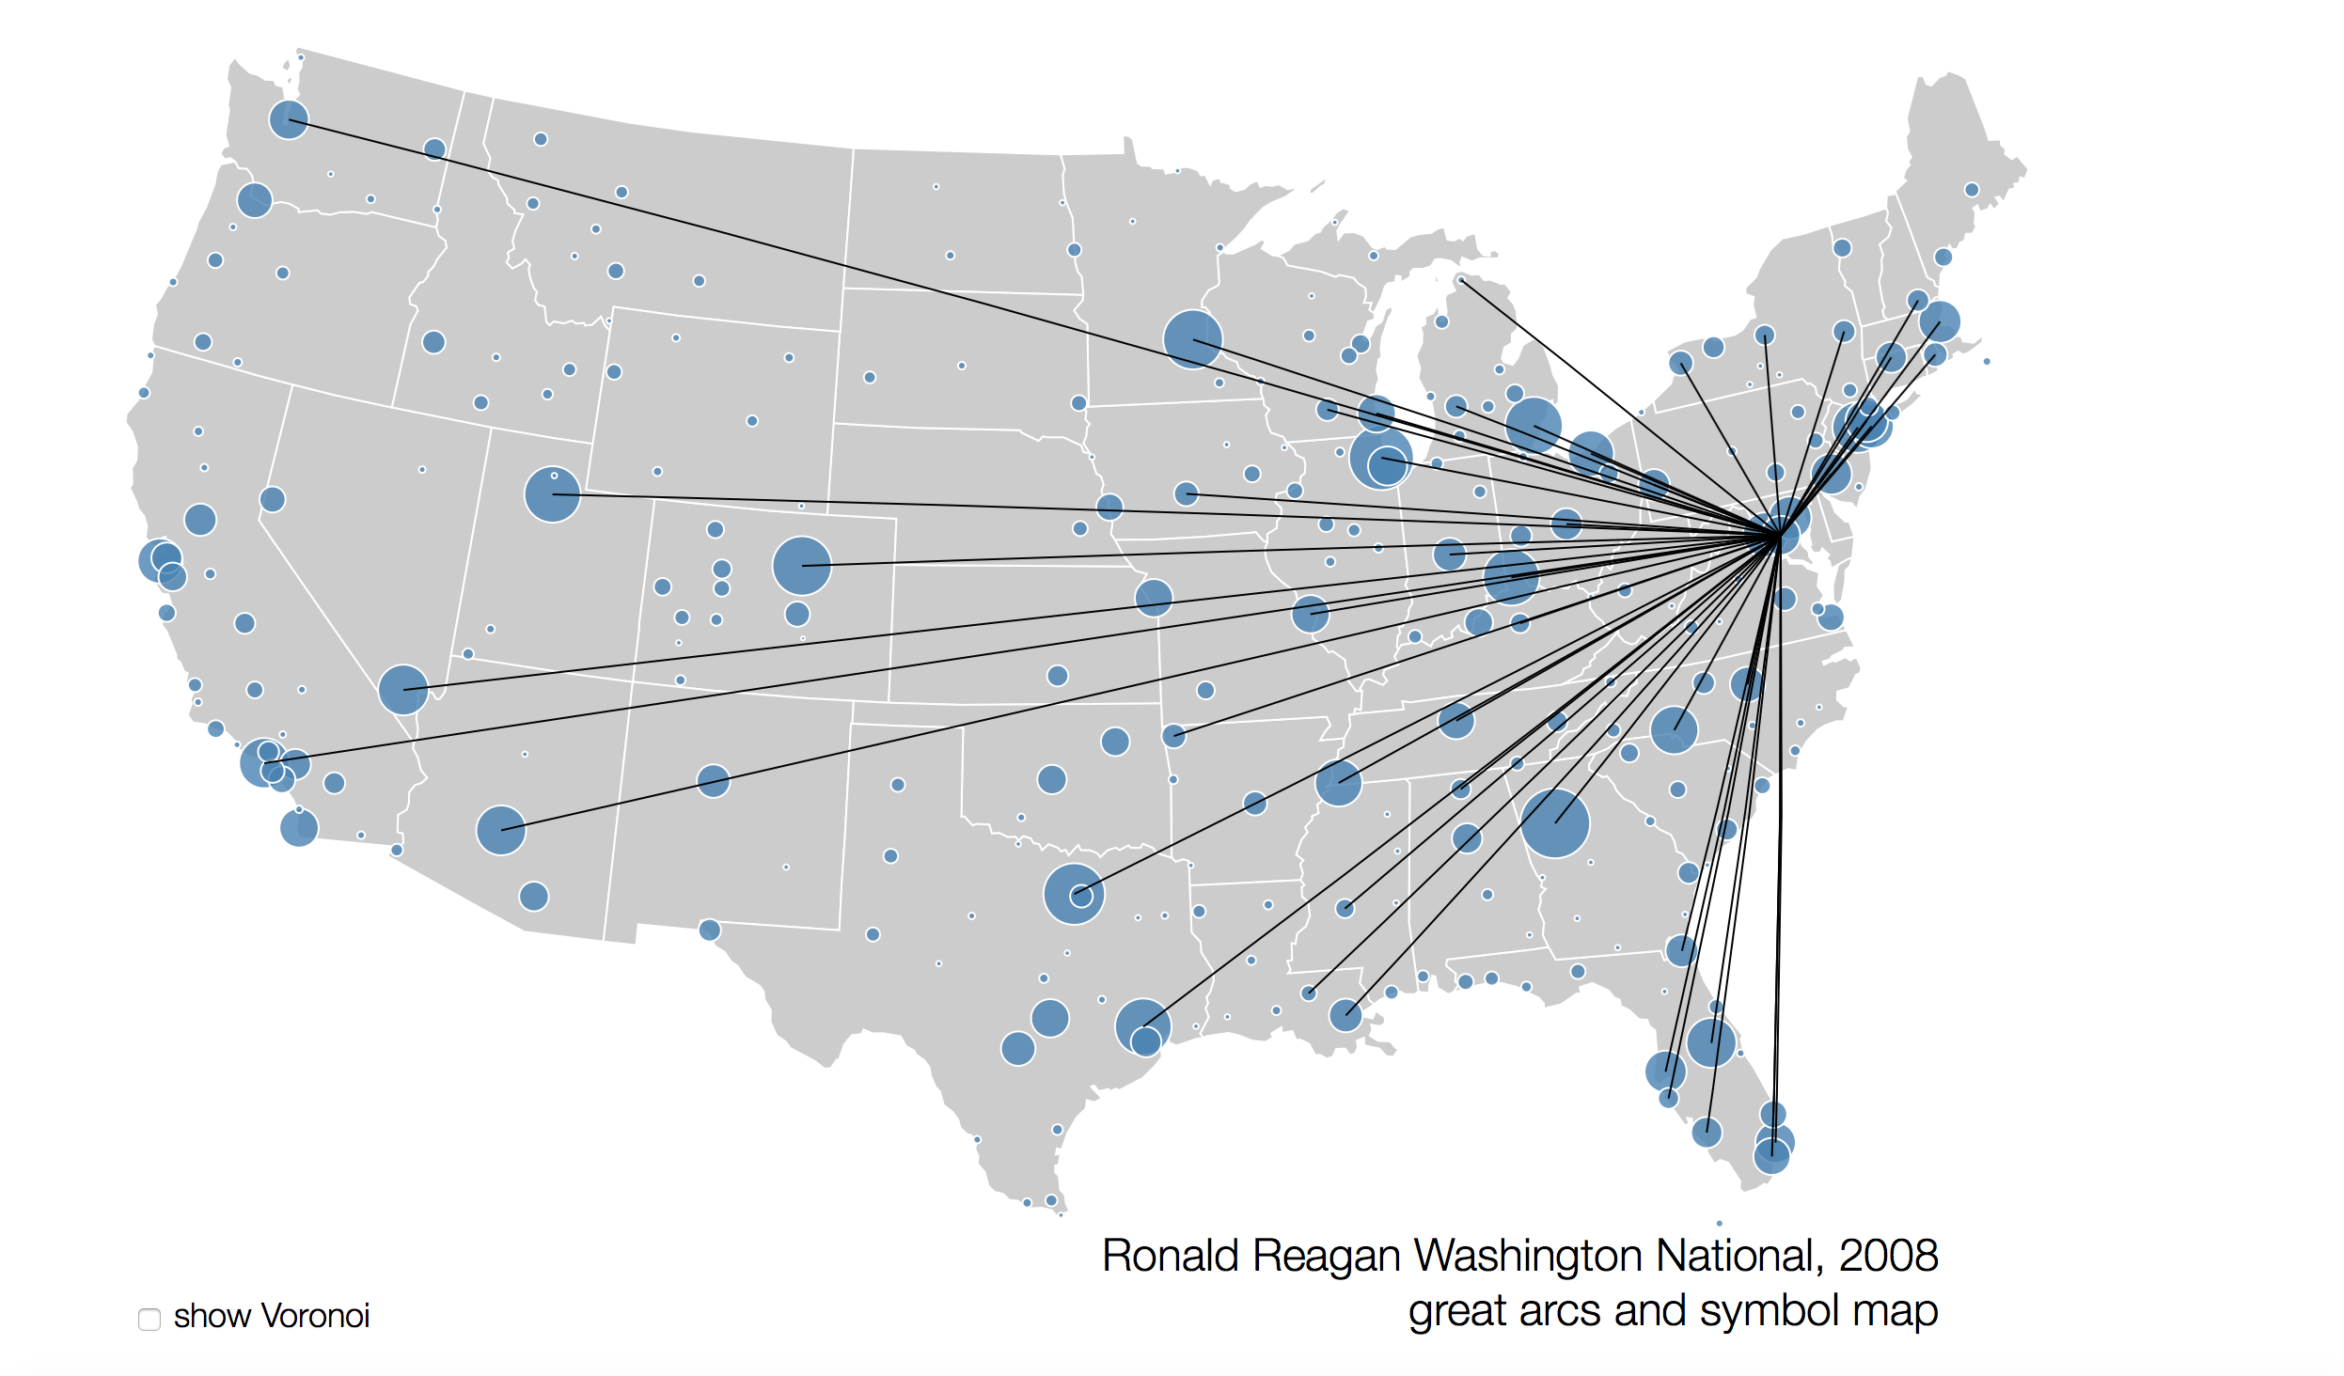
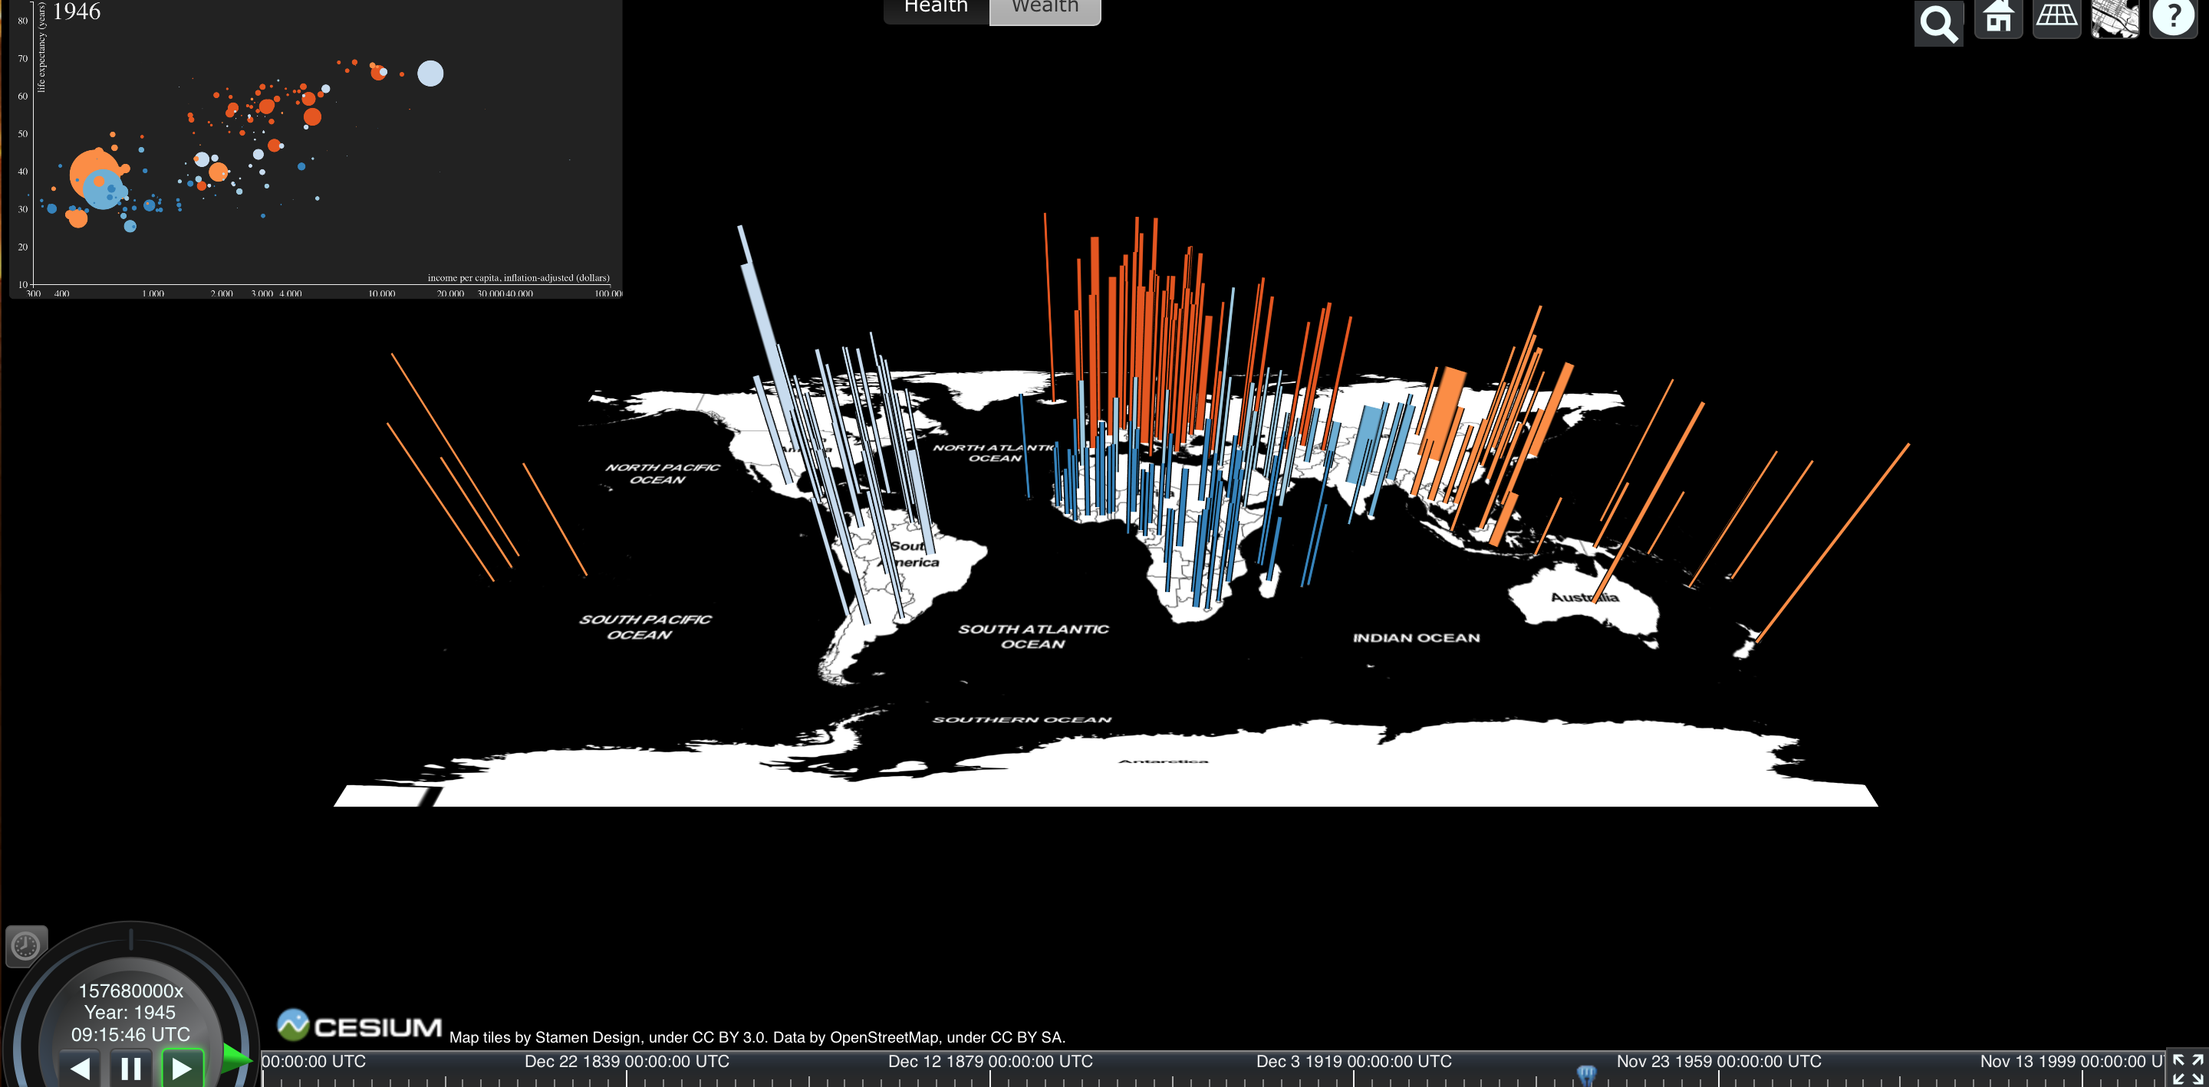
Existing Work

Slide 7
Visualization Techniques
A time series visualization with YEAR clock synced with Bar transitions.
Along with year clock, we have some basic stats animating using the text tweens
Groups tat contain elements like text and rectangles that animate over time.
To visually understand the magnitude we have a legend

Slide 8
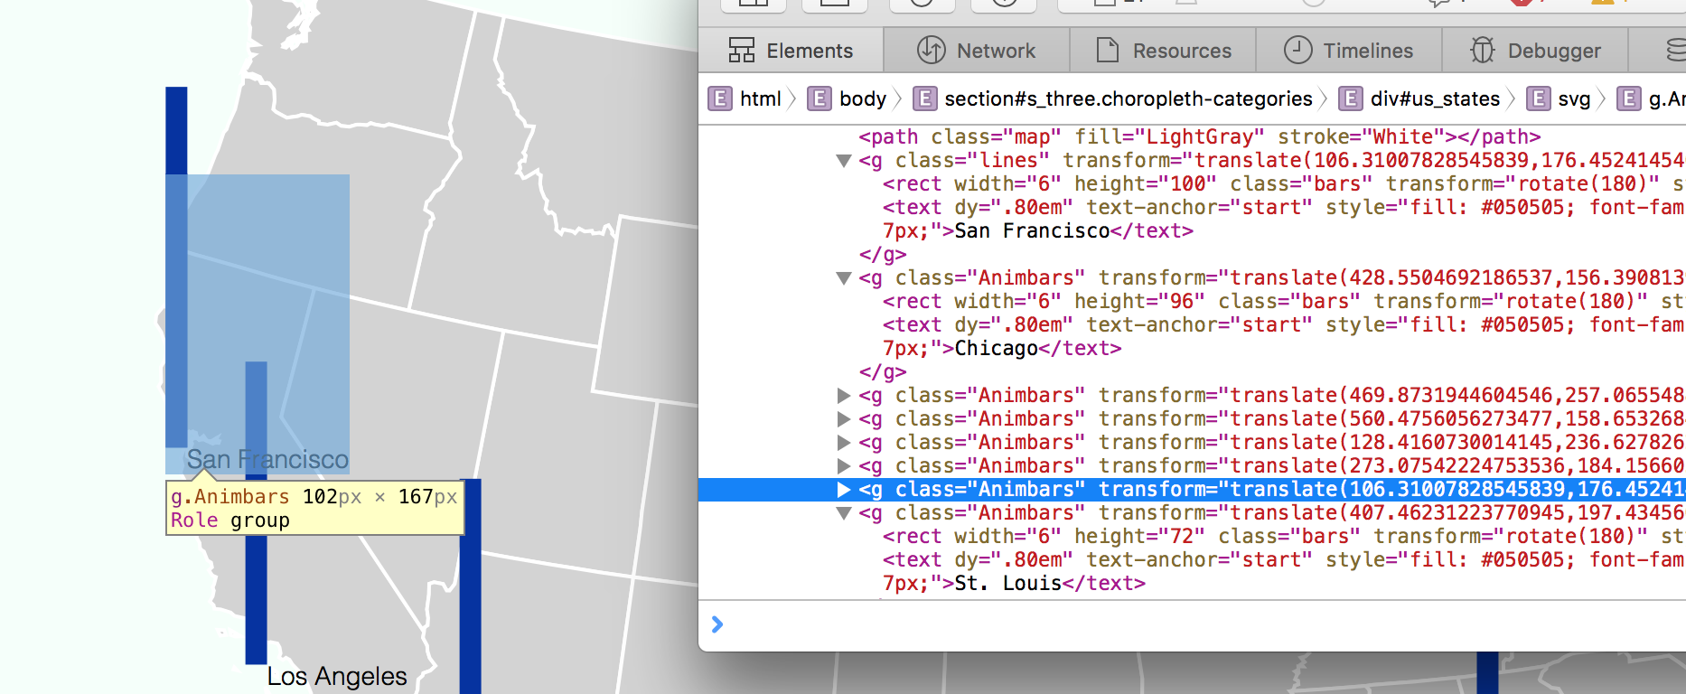
Viz Technique cont.
Linerar scalling !
--For the Magnitude of bars
--The linegraph data scales
Groups containing [ Bars + Text label + mouse over event call]

Slide 9
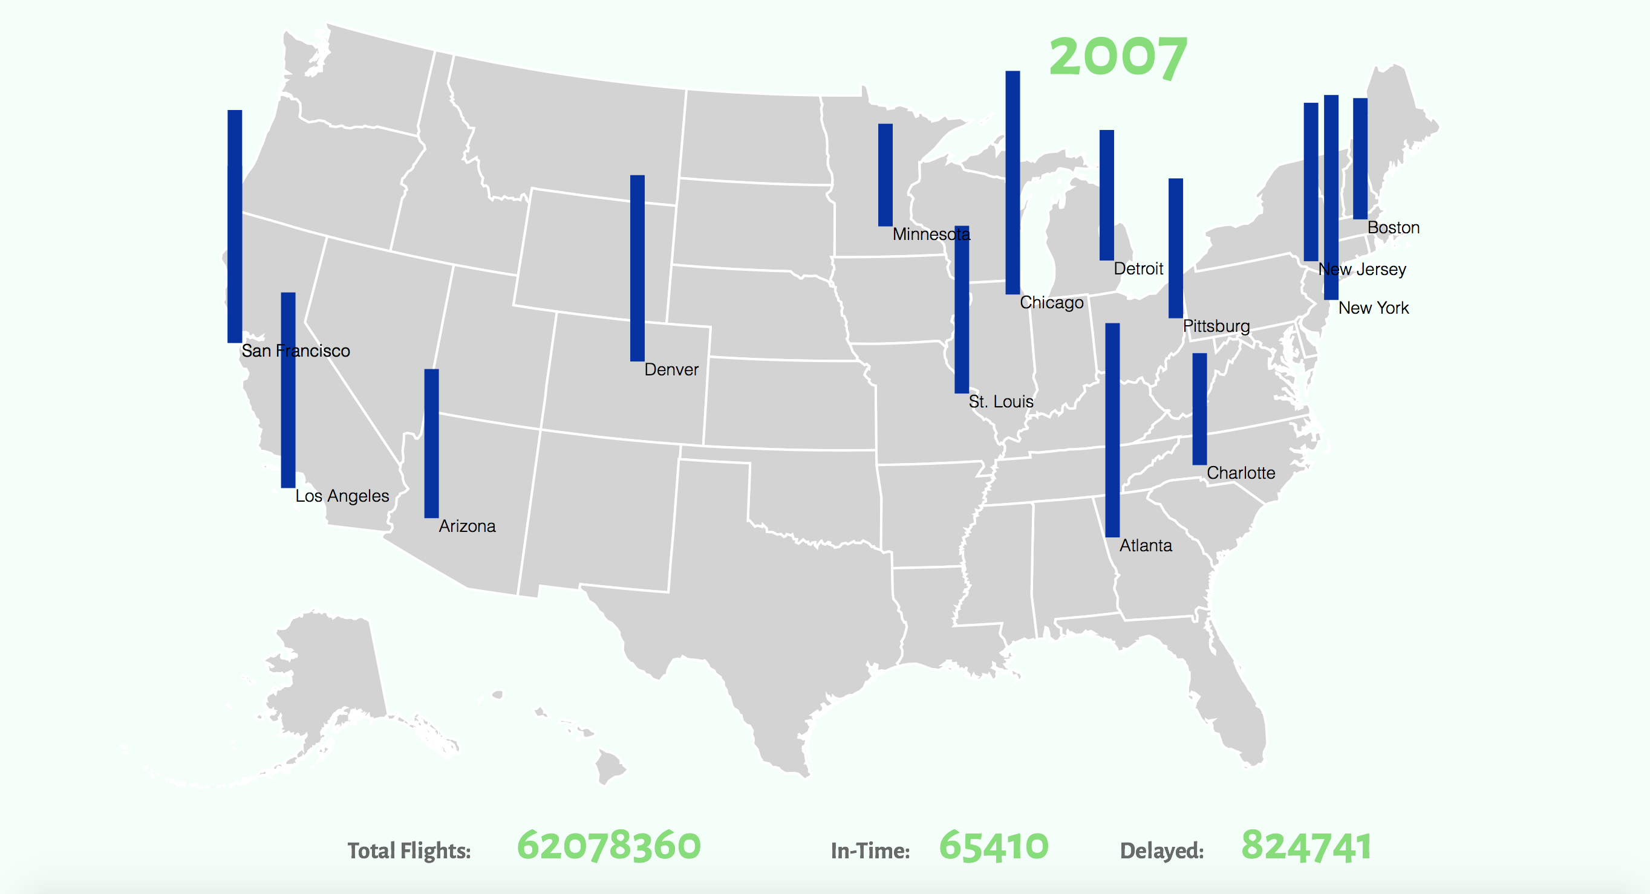
Our visualization, half way!

Slide 10
Suggestions
We had initially considered only placing bar’s to show the magnitude of increase in traffic at different airports
After discussion with YY, he suggested we reconsider since the information could better be represented as in the below visualization by nytimes
We now create a trend chart for each of the airports to show how the count of incoming and outgoing flights have changed over the years
This chart is now overlaid on the map

Slide 11
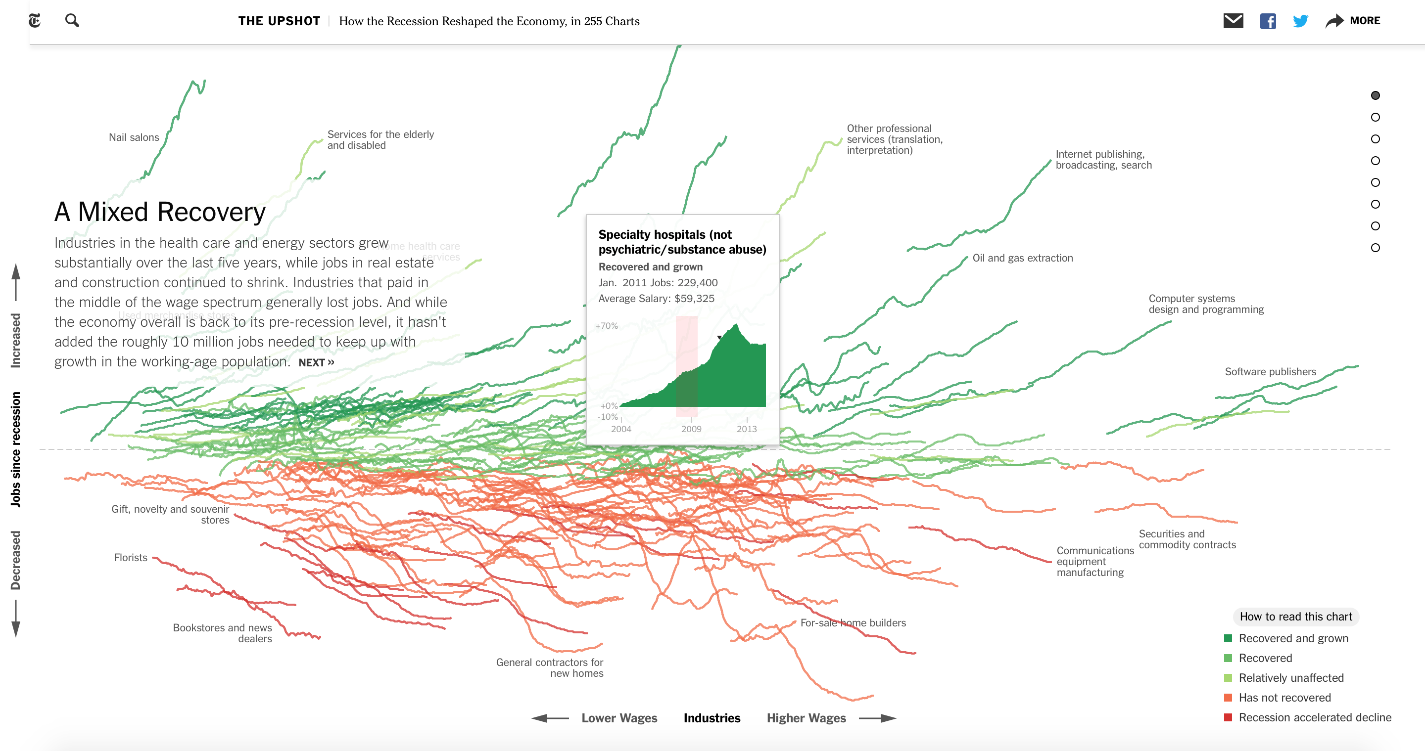
On hover

Slide 12
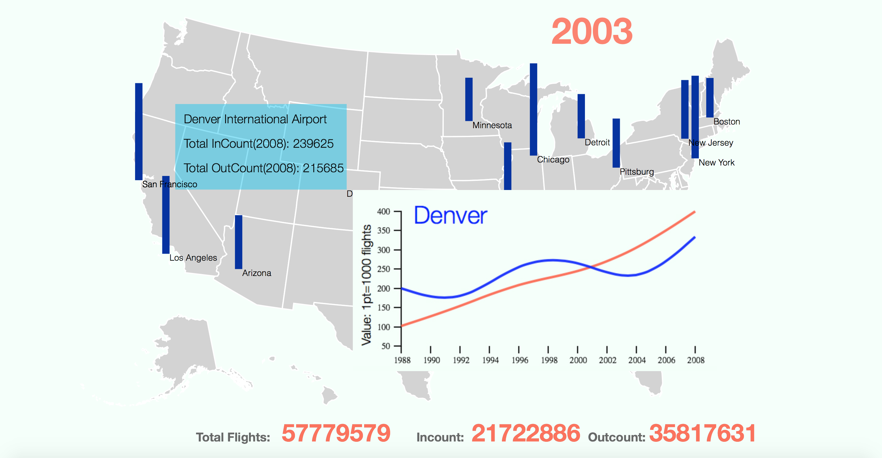
Our Outcome:

Slide 13
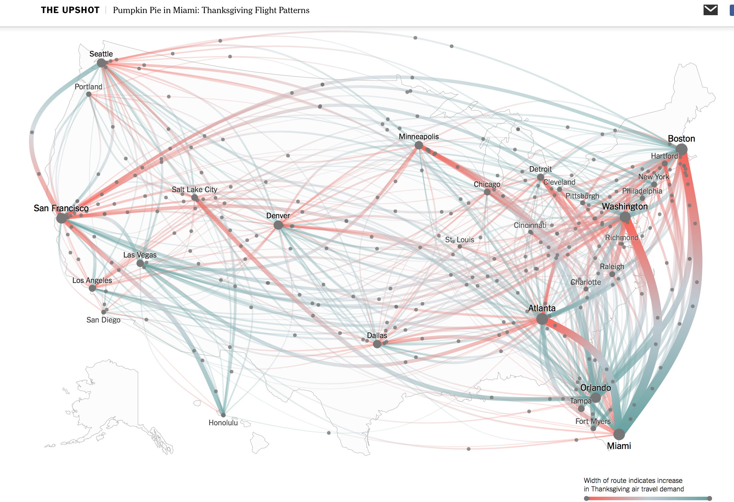
Future work: Thanksgiving Flight Pattern

Slide 14
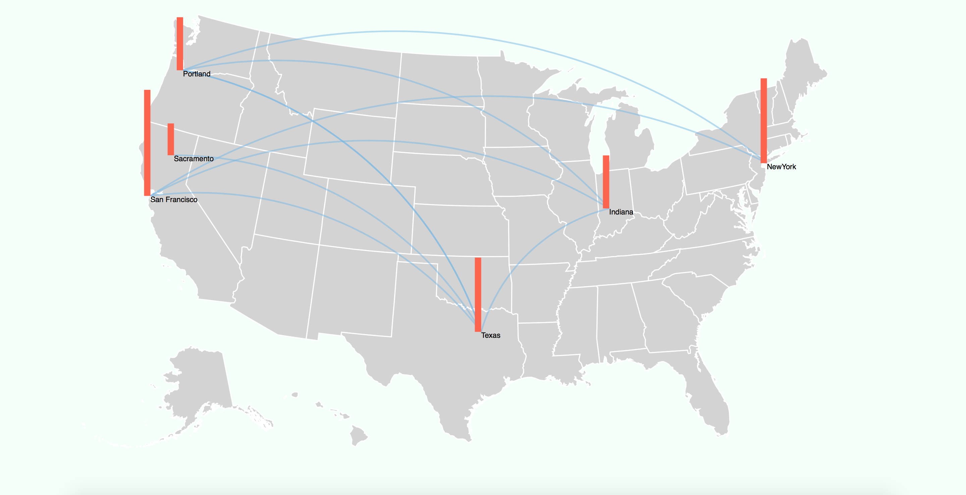
Our Route Projections
We used Lat/Lng pairs to generate path:

Slide 15
Insights
We saw that a lot of factors influence the numbers… We had initially thought the count of incoming and outgoing traffic would increase year on year for a certain busy airport..
We had not realised that factors like recession and other factors would reduce the number of operations at certain airports..Or airlines would choose their hubs and those airports would be the layover locations and would continue to become more busy

Slide 16
References
http://www.aaronkoblin.com/work/flightpatterns/
https://www.processing.org/examples/
http://bl.ocks.org/mbostock/5851933
https://flowingdata.com/2009/09/10/3-in-depth-views-of-flight-delays-and-cancellations/
http://www.transtats.bts.gov/OT_Delay/OT_DelayCause1.asp
http://projects.fivethirtyeight.com/flights/

Slide 17
Thank You

